Slide 1
Module 4

Slide 2
Email Security
Security services for email:

Slide 3
Electronic Mail Security
To provide authentication and confidentiality in e-mail we use two methods
Pretty Good Privacy
S/MIME
Pretty Good Privacy (PGP)
PGP provides a confidentiality and authentication service that can be used for electronic mail and file storage applications. This is the effort of a single person Zimmerman. PGP has grown explosively and is now widely used. A number of reasons can be cited for this growth.
It is available free worldwide in versions that run on a variety of platforms, including Windows, UNIX, Macintosh, and many more.
It is based on algorithms that have survived extensive public review and are considered extremely secure. Specifically, the package includes RSA, DSS, and Diffie-Hellman for public-key encryption; CAST-128, IDEA, and 3DES for symmetric encryption; and SHA-1 for hash coding

Slide 4
It has a wide range of applicability, from corporations that wish to select and enforce a standardized scheme for encrypting files and messages to individuals who wish to communicate securely with others worldwide over the Internet and other networks.
It was not developed by, nor is it controlled by, any governmental or standards organization.
PGP is now on an Internet standards track (RFC 3156). The actual services of PGP consists of five operations.
Authentication
Confidentiality
Compression
E-mail compatibility
Segmentation

Slide 5
Authentication
The sequence in authentication is as follows
The sender creates a message.
SHA-1 is used to generate a 160-bit hash code of the message.
The hash code is encrypted with RSA using the sender‟s private key, and the result is prepended to the message.
The receiver uses RSA with the sender‟s public key to decrypt and recover the hash code.
The receiver generates a new hash code for the message and compares it with the decrypted hash code. If the two match, the message is accepted as authentic.

Slide 6
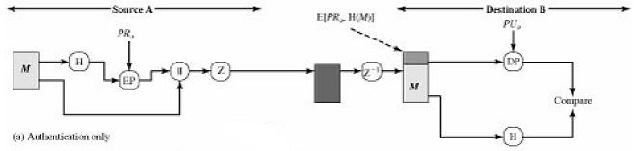
The combination of SHA-1 and RSA provides an effective digital signature scheme. Because of the strength of RSA, the recipient is assured that only the possessor of the matching private key can generate the signature. Because of the strength of SHA-1, the recipient is assured that no one else could generate a new message that matches the hash code and, hence, the signature of the original message.

Slide 7
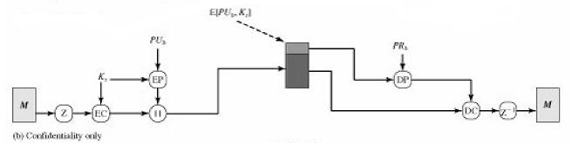
Confidentiality
Another basic service provided by PGP is confidentiality, which is provided by encrypting messages to be transmitted or to he stored locally as files. In both cases, the symmetric encryption algorithm CAST-128 may be used. The sequence can be described as follows.
The sender generates a message and a random 128-bit number to be used as a session key for this message only.
The message is encrypted, using CAST-128 (or IDEA or 3DES) with the session key.

Slide 8
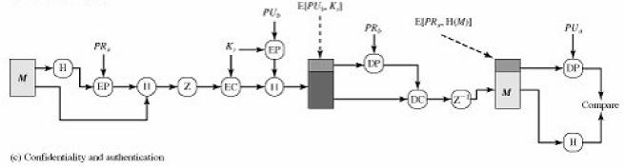
The session key is encrypted with RSA, using the recipient‟s public key, and is prepended to the message.
The receiver uses RSA with its private key to decrypt and recover the session key.
The session key is used to decrypt the message.
Confidentiality and Authentication

Slide 9
Both services may be used for the same message. First, a signature is generated for the plaintext message and prepended to the message. Then the plaintext message plus signature is encrypted using CAST-128 (or IDEA or 3DES), and the session key is encrypted using RSA. This sequence is preferable to the opposite: encrypting the message and then generating a signature for the encrypted message. It is generally more convenient to store a signature with a plaintext version of a message. Furthermore, for purposes of third-party verification, if the signature is performed first, a third party need not be concerned with the symmetric key when verifying the signature. In summary, when both services are used, the sender first signs the message with its own private key, then encrypts the message with a session key, and then encrypts the session key with the recipient‟s public key. In summary, when both services are used, the sender first signs the message with its own private key, then encrypts the message with a session key, and then encrypts the session key with the recipient‟s public key. Compression As a default, PGP compresses the message after applying the signature but before encryption. This has the benefit of saving space both for e-mail transmission and for file storage.

Slide 10
Compression
As a default, PGP compresses the message after applying the signature but before encryption. This has the benefit of saving space both for e-mail transmission and for file storage. The placement of the compression algorithm, indicated by Z for compression and Z-1 for decompression is critical: The signature is generated before compression for two reasons:
It is preferable to sign an uncompressed message so that one can store only the uncompressed message together with the signature for future verification If one signed a compressed document, then it would be necessary either to store a compressed version of the message for later verification or to recompress the message when verification is required.
Even if one were willing to generate dynamically a recompressed message for verification, PGP‟s compression algorithm presents a difficulty. The algorithm is not deterministic; various implementations of the algorithm achieve different tradeoffs in running speed versus compression ratio and, as a result, produce different compressed forms. However, these different compression algorithms are interoperable because any version of the algorithm can correctly decompress the output of any other version. Applying the hash function and signature after compression would constrain all PGP implementations to the same version of the compression algorithm.
E-mail Compatibility
When PGP is used, at least part of the block to be transmitted is encrypted. If only the signature service is used, then the message digest is encrypted (with the sender‟s private key). If the confidentiality service is used, the signatures message plus signature (if present) are encrypted (with a one-time symmetric key).

Slide 11
S/MIME
Secure/Multipurpose Internet Mail Extension is an e-mail security standard. PGP is used for personal e-mail security and S/MIME is for commercial purpose. The five header fields defined in MIME are as follows:
MIME-Version: Must have the parameter value 1.0. This field indicates that the message conforms to RFCs 2045 and 2046.
Content-Type: Describes the data contained in the body with sufficient detail that the receiving user agent can pick an appropriate agent or mechanism to represent the data to the user or otherwise deal with the data in an appropriate manner.
Content-Transfer-Encoding: Indicates the type of transformation that has been used to represent the body of the message in a way that is acceptable for mail transport.
Content – ID Used to identify MIME entities uniquely in multiple contexts.
Content –Description A text description of the object within the body.

Slide 12
S/MIME Functionality:
S/MIME provides the following functions:
Enveloped data: This consists of encrypted content of any type and encrypted content encryption keys for one or more recipients.
Signed data: A digital signature is formed by taking the message digest of the content to be signed and then encrypting that with the private key of the signer. The content plus signature are then encoded using base64 encoding. A recipient can only view a signed data message with S/MIME capability.
Clear-signed data: As with signed data, a digital signature of the content is formed. However, only the digital signature is encoded using base64. As a result, recipients without S/MIME capability can view the message Content, although they cannot verify the signature.
Signed and enveloped data: Signed-only and encrypted-only entities may be nested, so that encrypted data may be signed and signed data or clear-signed data may be encrypted.

Slide 13
S/MIME Messages
Securing a MIME Entity
S/MIME secures a MIME entity with a signature, encryption, or both. An entity may be an entire message, or if the content type is multipart, then a MIME entity is one or more of the subparts of the message. The MIME entity is prepared according to the normal rules for MIME sage preparation. Then the MIME entity plus some security-related data such as algorithm identifiers and certificates are processed by S/MIME to produce what is
Enveloped Data
An application lpkcs7-mime subtype is used for one of four categories of S/MIME processing, each with a unique s/mime-type parameter. In all cases, the resulting entity, referred to as an object, is represented in a form known as Basic. Encoding Rules (BER), which is defined in ITU-T Recommendation X.209? The BER format consists of arbitrary octet strings and is therefore binary data. Such an object should be transfer encoded with base64 in the outer MIME message. The steps for preparing an enveloped Data MIME entity are as follows.
Generate a pseudorandom session key for a particular symmetric encryption algorithm.
For each recipient, encrypt the session key with the recipient's public key
For each recipient, prepare a block known as Recipient Info that contains an identifier of the recipient's public-key certificate an identifier of the algorithm used to encrypt the session key, and the encrypted session key.
Encrypt message content with the session key.

Slide 14
Signed Data
The signed Data s/mime-type can actually be used with one or more signers. The steps for preparing a signed Data MIME entity are as follows:
Select a message digest algorithm (SHA or MD5).
Compute the message digest, or hash function, of the content to be signed.
Encrypt the message digest with the signer's private key.
Prepare a block known as Signer info that contains the signer's public-key certificate, an identifier of the message digest algorithm, an identifier of the algorithm used to encrypt the message digest, and the encrypted message digest
Clear Signing
Clear signing is achieved using the multipart content type with a signed subtype. This signing process does not involve transforming the message to be signed, so that the message is sent “in the clear.” Thus, recipient with MIME capability but not S/MIME capability are able to read the incoming message. A multipart/signed message has two parts. The first part can be any type but must be prepared so that it will not be altered during transfer from source to destination. This means that if the first part is not 7bit, then it needs to be encoded using base64 or quoted- printable. Then this part is processed in the same manner as signed Data, but in this case an object with signed Data format is created that has an empty message content field. This object is a detached signature. It then transfer encoded using base64 to become the second part of the multipart signed message. This second part has a MIME content type of application and a subtype of pkcs7-signature.

Slide 15
IP Security
Definition - What does Internet Protocol Security (IPsec)mean?
Internet protocol security (IPsec) is a set of protocols that provides security for Internet Protocol. It can use cryptography to provide security. IPsec can be used for the setting up of virtual private networks (VPNs) in a secure manner.Also known as IP Security.
IPSec provides the capability to secure communication across a LAN, across private and Public WANs and across the internet.
Applications of IPSec
Secure branch office connectivity over the Internet: A company can I secure virtual private network over the Internet or over a public WAN. This enables a business to rely heavily on the Internet and reduce its need for private networks, saving costs and network management overhead.
Secure remote access over the internet: An end user whose system is equipped with IP security protocols can make a local call to an Internet service provider and gain secure access to the company network. This reduces the toll charges for traveling employees and telecommuters.
Establishing extranet and intranet connectivity with partners: IPSec used to secure communication with other organizations, ensuring authentication and confidentiality and providing a key exchange mechanism.
Enhancing electronic commerce security: Even though some Web an electronic commerce applications have built-in security protocols, the use of IPSec enhances that security.

Slide 16
Benefits of IPSec
When IPSec is implemented on a firewall or a router it provides strong security that can be applied to all traffic crossing the perimeter.
IPSec in a firewall is resistant to bypass if all traffic from the outside must us IP, and the firewall is the only means of entrance from the Internet into the organization.
IPSec is below the transport layer (TCP, UDP) and so is transparent to applications. There is no need to change software on a user or server system when IPSec is implemented in the firewall or router. Even if IPSec is implemented in end systems, upper-layer software, including applications, is not affected.
IPSec can be transparent to end users. There is no need to train users on security mechanisms, issue keying material on a per-user basis, or revoke keying material when users leave the organization.
IPSec can provide security for individual users if needed. This is useful offsite workers and for setting up a secure virtual sub network within an organization for sensitive applications.

Slide 17
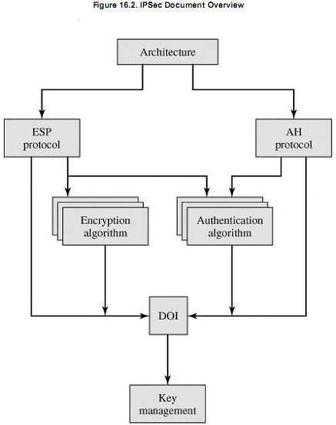
IP Security Architecture
IP security consists of a number of documents. The documents are divided in to seven groups which are given below. Architecture: Covers the general concepts, security requirements, definitions, and mechanisms defining IPSec technology.

Slide 18
Encapsulation Security Payload (ESP): Covers the packet format and general issues related to the use of the ESP for packet encryption and, authentication.
Authentication Header (AH): Covers the packet format and general issues related to the use of AH for packet authentication.
Encryption Algorithm: A set of documents that describe how various encryption algorithms are used for ESP.
Authentication Algorithm: A set of documents that describe how various authentication algorithms are for AH for packet authentication and for the authentication option of ESP.

Slide 19
IPSec Services
IPSec provides security services at the IP layer by enabling a system to required security protocols, determine the algorithm(s) to use for the services and put in place any cryptographic keys required to provide, the sevices. Two protocols are used to provide security: An authentication protocol designated by the header of the protocol, Authentication Header (AH) combined encryption / authentication protocol designated by the format of packet for that protocol, Encapsulating Security Payload (ESP). The service as follows:
Access control
Connectionless integrity
Data origin authentication
Confidentiality
Limited traffic flow confidentiality
IPsec involves two security services(Two Protocols):
Authentication Header (AH): This authenticates the sender and it discovers any changes in data during transmission.
Encapsulating Security Payload (ESP): This not only performs authentication for the sender but also encrypts the data being sent.

Slide 20
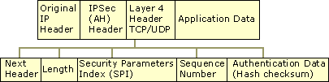
Authentication Header
Authentication Header (AH) provides authentication, integrity, and anti-replay for the entire packet (both the IP header and the data payload carried in the packet). It does not provide confidentiality, which means it does not encrypt the data. The data is readable, but protected from modification. AH uses the HMAC algorithms described earlier to sign the packet for integrity.
For example, Alice on Computer A sends data to Bob on Computer B. The IP header, the AH header, and the data are protected with integrity. This means Alice can be certain it was really Bob who sent the data and that the data was unmodified.
Integrity and authentication are provided by the placement of the AH header between the IP header and the transport (layer 4) protocol header, which is shown as TCP/UDP in the Figure 8.1. AH uses an IP protocol ID of 51 to identify itself in the IP header.
Figure:- Authentication Header

Slide 21
AH can be used alone or in combination with the Encapsulating Security Payload (ESP) protocol.
The AH header contains the following fields:
Next Header Identifies the next header that uses the IP protocol ID. For example, the value might be "6" to indicate TCP.
Length Indicates the length of the AH header.
Security Parameters Index (SPI) Used in combination with the destination address and the security protocol (AH or ESP) to identify the correct security association for the communication. (For more information, see the "Internet Key Exchange" section later in this chapter.) The receiver uses this value to determine with which security association this packet is identified.

Slide 22
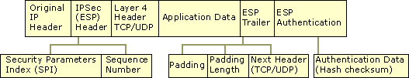
Encapsulating Security Payload
Encapsulating Security Payload (ESP) provides confidentiality, in addition to authentication, integrity, and anti-replay. ESP can be used alone, or in combination with AH.
ESP does not normally sign the entire packet unless it is being tunneled— ordinarily, just the IP data payload is protected, not the IP header.
For example, Alice on Computer A sends data to Bob on Computer B. The data payload is encrypted and signed for integrity. Upon receipt, after the integrity verification process is complete, the data payload in the packet is decrypted. Bob.
can be certain it was really Alice who sent the data, that the data is unmodified, and that no one else was able to read it.
ESP indicates itself in the IP header using the IP protocol ID of 50. As shown in the Figure 8.3, the ESP header is placed prior to the transport layer header (TCP or UDP) or the IP payload data for other IP protocol types.
Fig: ESP packect format

Slide 23
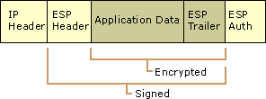
Authentication Data Contains the Integrity Check Value (ICV), and a message authentication code that is used to verify the sender's identity and message integrity. The ICV is calculated over the ESP header, the payload data and the ESP trailer
Packet Signature and Encryption
As shown in Figure 8.4, ESP provides protection for upper layer protocols. The Signed area indicates where the packet has been signed for integrity. The Encrypted area indicates what information is protected with confidentiality.
Fig: ESP signature & encryption.

Slide 24
ESP is inserted after the IP header and before an upper layer protocol, such as TCP, UDP, or ICMP, or before any other IPSec headers that have already been inserted. Everything following ESP (the upper layer protocol, the data, and the ESP trailer) is signed. The IP header is not signed, and therefore not necessarily protected from modification. The upper layer protocol information, the data, and the ESP trailer are encrypted.
Two modes of operation in ipsec
1 . Tunnel mode
2. Transport mode
IPSEC TUNNEL MODE
IPSec tunnel mode is the default mode. With tunnel mode, the entire original IP
packet is protected by IPSec. This means IPSec wraps the original packet, encrypts it, adds a new IP header and sends it to the other side of the VPN tunnel (IPSec peer).
Tunnel mode is most commonly used between gateways (Cisco routers or ASA firewalls), or at an end-station to a gateway, the gateway acting as a proxy for the hosts behind it.
Tunnel mode is used to encrypt traffic between secure IPSec Gateways, for example two Cisco routers connected over the Internet via IPSec VPN. Configuration and setup of this topology is extensively covered in our Site-to-Site IPSec VPN article. In this example, each router acts as an IPSec Gateway for their LAN, providing secure connectivity to the remote network:

Slide 25
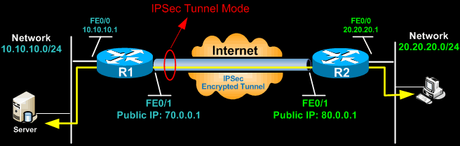
Tunnel mode is most commonly used between gateways (Cisco routers or ASA firewalls), or at an end-station to a gateway, the gateway acting as a proxy for the hosts behind it.
Tunnel mode is used to encrypt traffic between secure IPSec Gateways, for example two Cisco routers connected over the Internet via IPSec VPN. Configuration and setup of this topology is extensively covered in our Site-to-Site IPSec VPN article. In this example, each router acts as an IPSec Gateway for their LAN, providing secure connectivity to the remote network:
Another example of tunnel mode is an IPSec tunnel between a Cisco VPN Client and an IPSec Gateway (e.g ASA5510 or PIX Firewall). The client connects to the IPSec Gateway. Traffic from the client is encrypted, encapsulated inside a new IP packet and sent to the other end. Once decrypted by the firewall appliance, the client’s original IP packet is sent to the local network.
In tunnel mode, an IPSec header (AH or ESP header) is inserted between the IP header and the upper layer protocol. Between AH and ESP, ESP is most commonly used in IPSec VPN Tunnel configuration.

Slide 26
The packet diagram below illustrates IPSec Transport mode with AH header:
Header format of IPV4
Header format of IPV6
Implementation of AH protocol in IPV4
Implementation of AH protocol in IPV6
Transport Mode
Original IP Header | TCP | Data
Original IP header | Extension Header | TCP | Data
Original IP header | AH | TCP | Data
Orginal IP header | Extension header | AH | TCP | DAta

Slide 27
The packet diagram below illustrates IPSec Tunnel mode with AH header:
IPV4
IPV6
New IP Header | AH | Orginal IP header | TCP | DATA
New IP Headre | Extension Header | AH | Orginal IP Header | Extension Header | TCP | DATA

Slide 28
The packet diagram below illustrates IPSec Transport mode with ESP header:
IPV4 header format after implementation of ESP
IPV6 header format after implementation of ESP
Transport Mode
Orginal IP header | ESP header | TCP | Data | ESP trailer | ESP authentication
Orginal IP header | Extension header | ESP header | TCP | Data | ESP trailer | ESP authentication

Slide 29
Tunnel mode with ESP header:
IPv4
IPv6
New IP header | ESP header | Original IP header | TCP | DATA | ESP trailer | ESP authentication
New IP Header | Extension Heder | ESP header | Orginal IP header | Extension Header | TCP | Data | ESP trailer | ESP authentication

Slide 30
Security Association (SA)
Internet Protocol Security (IPsec) is a secure network protocol suite that authenticates and encrypts the packets of data to provide secure encrypted communication between two computers over an Internet Protocol network. It is used in virtual private networks (VPNs).
Security Association(SA)- It is a temporary communication link b/w two systems. It is a
one way communication of client and server.
Client Server . Here there are 2 Security Associations
are there in b/w client & server
Several parameters are associated with SA
Security Association parameters :
To identify Security Association 3
parameters are there.
Security Parameter Index(SPI).This will be carried out in both AH & ESP protocol. SPI is the unique number given to SA.
IP Destination address. Address of the destination.
Protocol Identifier: This specifies which protocol the SA is used. i.e ESP/AH.

Slide 31
Parameters which are associated with SA are stored in Security Association Database(SAD)
1.SPI- unique identification of particular SA
2.Sequence Number Counter.
3.Sequence Number Overflow- where to stop the message.
4. Anti-replay Window- to avoid receiving the duplicate packets
5. AH information- It gives information about which are the authentication & signatures algorithms used in the AH protocol
6.ESP information
7. Life time of SA
8. IPSec protocol mode- Transportmode, Tunnel mode

Slide 32
Key Management
Key management in two ways
Manual( for small N/W)
Automated(for large N/W)- two protocols used in automated key management. They are
i) Oakley key management protocol- it is the refinment of Diffie-Helman Key exchange
ii) ISAKMP(Internet Security association Key Management Protocol)

Slide 33
Web Security
Web security is protecting a website or web application by detecting, preventing and responding to cyber threats.
SSL(Secure Socket Layer) Protocol- to provide web security.
SSL is implemented using the following protocols:
SSL Record Protocol
Handshake Protocol
Change cipher spec protocol
Alert protocol
The above protocols are known as SSL protocol stack.
SSL protocol implemented just above TCP/IP and just below HTTP.

Slide 34
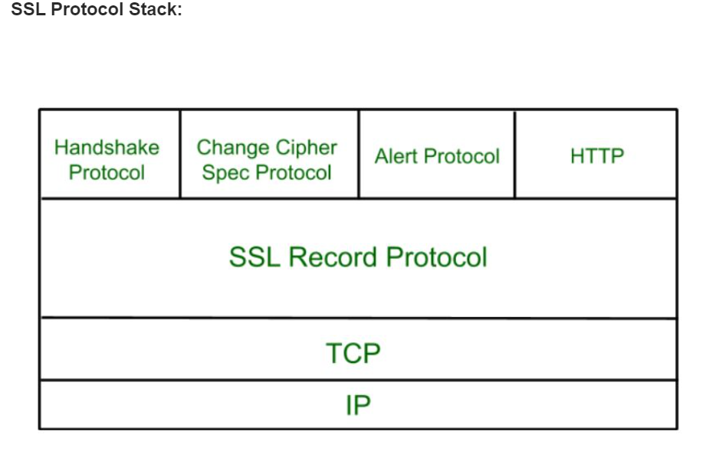
SSL

Slide 35
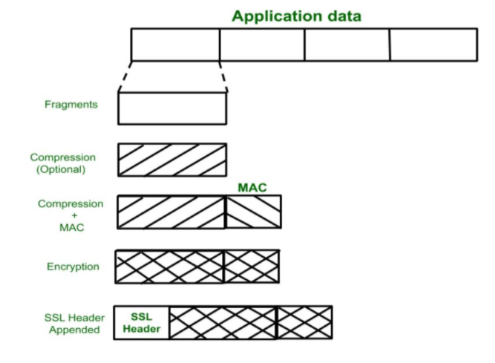
SSL Protocol
SSL Record Protocol:
SSL Record provide two services to SSL connection.
Confidentiality
Message Integerity
In SSL Record Protocol application data is divided into fragments. The fragment is compressed and then encrypted MAC (Message Authentication Code) generated by algorithms like SHA (Secure Hash Protocol) and MD5 (Message Digest) is appended. After that encryption of the data is done and in last SSL header is appended to the data.

Slide 36
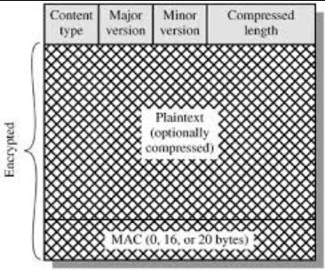
SSL Record Protocol:
Fields of SSL Header
Content Type- It mention the higher layer protocol to which the compressed & encrypted fragment will be send.
Major version- 3
Minor Version- 0
Compressed Length: Length of the compressed fragment.
SSL RECORD PROTOCOL Diagram

Slide 37
SSL Record Protocol:
Message authentication code is calculated over the data using a shared secret key as follows:
hash(MAC_write_secret || pad_2 || hash(MAC_write_secret || pad_1 || seq_num || SSLCompressed.type || SSLCompressed.length || SSLCompressed.fragment) )
where: || represents concatenation
MAC_write_secret represents the shared secret key
hash represents the cryptographic hash algorithm (either MD5 or SHA-1).
pad_1 represents the 01010110 repeated 48 times for MD5 and 40 times for SHA-1.
pad_2 represents the 00110110 repeated 48 times for MD5 and 40 times for SHA-1.
seq_num represents the sequence number for this fragment.
SSLCompressed.type represents the higher level protocol used to process this message.
SSLCompressed.length represents the length of the compressed fragment.
SSLCompressed.fragment represents the compressed (or plaintext) fragment.

Slide 38

Handshake Protocol:
Handshake protocol represented using 3 fields:
Type: A 8-bit field indicating the type . Type represents the higher layer protocol
Length of Message: A 3-byte field-length field. Messages involved in handshake protocol:
Client hello
Server Hello
Certificates (x.509)
Server_Key_Exchange
Certificate request
Server done
Client_Key_Exchange
Certificate verify
Finished
Content: >=0-byte field for message parameters

Slide 39
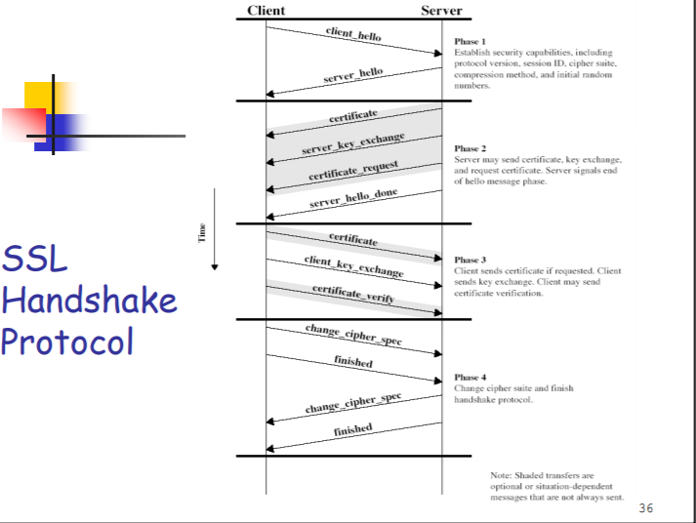
Handshake Protocol
Handshake Protocol is used to establish sessions. This protocol allow client and server to authenticate each other by sending a series of messages to each other. Handshake protocol uses four phases to complete its cycle.
Phase-1: In Phase-1 both Client and Server send hello-packets to each other. In this IP session, cipher suite and protocol version are exchanged for security purpose.
Phase-2: Server send his certificate and Server-key-exchange. Server end the phase-2 by sending Server-hello-end packet.
Phase-3: In this phase Client reply to the server by sending his certificate and Client-exchange-key
Phase-4: In Phase-4 Change-cipher suite occurred and after this Handshake Protocol ends.

Slide 40

Change-cipher Spec Protocol
This protocol uses SSL record protocol. Unless Handshake Protocol is completed, the SSL record Output will be in pending state. After handshake protocol the Pending state is converted into Current state. Change-cipher protocol consists of single message which is 1 byte in length and can have only one value. This protocol purpose is to cause the pending state to be copied into current state.

Slide 41

Alert Protocol
This protocol is used to convey SSL-related alerts to the peer entity. Each message in this protocol contain 2 bytes.
Alert protocol represented in two fields: They are Level & Alert.
Level represents either warning or fatal error.
Warning- no impact on the connection
Fatal Error- The connection between client & server will be disconnected. So the connection must be reestablished.

Slide 42
Transport Layer Security (TLS)
Transport Layer Security (TLS) is the successor protocol to SSL. TLS is an improved version of SSL. It works in much the same way as the SSL, using encryption to protect the transfer of data and information. The two terms are often used interchangeably in the industry although SSL is still widely used.

Slide 43
What is client authentication?
Client Authentication is the process by which users securely access a server or remote computer by exchanging a Digital Certificate. The Digital Certificate is in part seen as your 'Digital ID' and is used to cryptographically bind a customer, employee, or partner's identity to a unique Digital Certificate (typically including the name, company name and location of the Digital Certificate owner). The Digital Certificate can then be mapped to a user account and used to provide access control to network resources, web services and websites.
The Digital Certificates used for client and device authentication may look the same as any other Digital Certificate that you may already be using within your organization, such as certificates for securing web services (SSL) or email/document signatures (digital signatures), but Digital Certificates are likely to have a few different properties depending on the use.
Client authentication can be used to prevent unauthorized access, or simply to add a second layer of security to your current username and password combination. Client authentication and access control also enables organizations to meet regulatory and privacy compliancy, as well as fulfil internal security policies using PKI-based two-factor authentication – 'something you have' (a GlobalSign Digital Certificate) and 'something you know' (an internally managed password.
The benefits of client authentication
Client authentication has multiple benefits as an authentication method especially when compared to the basic username and password method:
You can decide whether or not a user is required to enter a username and password
Encrypts transactions over the network, identifies the server and validates any messages sent

Slide 44
Validates the user identity using a trusted party (the Certificate Authority) and allows for centralized management of certificates which enables easy revocation
It is unique to the device it is installed on – cannot be ported to other devices
Restrict access by user, group, roles, or device based on Active Directory (using GlobalSign's Auto Enrolment Gateway (AEG) solution)
Serves more purposes than authentication such as integrity and confidentiality
Prevents malicious attacks/problems, including but not limited to phishing, keystroke logging and man-in-the-middle (MITM) attacks

Slide 45
Exportability
This refers to the exportability of SSL protocols. They are related to government regulations regarding restrictions of export of cryptographic algorithms.
It is illegal to use strong crypto for nondomestic transfer of data or export data.
In SSLv2 ,only 40 secret bits out of 128bits are allowed in symmetric keys.
And 512-bits RSA keys.
In SSLv3, Integrity keys computed the same way with only 40 secret bits out of 128bits are allowed in symmetric keys.
IV –initialisation vector is non-secret.
When a domestic server (e.g., 1024-bit RSA key) communicates with an external client the server creates an ephemeral key of 512-bits and signs it with it’s 1024-bit key

Slide 46
Secure Electronic Transactions(SET)
SET is a security specification designed to protect credict card transcations on the internet. It is a set of security protocols & formats.
Set provides 3 services:
Secure communication channel.
Trust using digital signatures.
Privacy.
The SET protocols are designed to the following requirements:
Provide confidentiality of ordering & payment information.
Ensure integrity of all transmitted data.
Provide authentication that a card holder is a legitimate user of a credit card.

Slide 47
4. Provide authentication that a merchant can accept credit card transaction through it’s relationship with a financial institution.
5. Ensure the use of best security practice & system design techniques.
6. Create a protocol that neither depends on transport security mechanisms nor prevents their use.
7. Facilitate & encourage interoperability among S/W, H/W providers.
SET participants are:
1.Card holder
2. Merchant
3. Issuer
4.Acquirer
5.Payment gateway 6.Certification authority.

Slide 48
Events required for a transaction
1.Customer opens an account.
2. Customer receives a certificate.
3. Merchant acquire certificate.
4. Customer places an order.
5. The merchant is verified.
6. Order and payment are sent.
7. Merchant request payment authorisation.
8. Merchant confirms the order.
9. Merchant provides goods or services.
10.Merchant requests payment.

